Slide 1

Support Vector Machines
Maximal Margin Classifier
Soft Margin Classifier (Support Vector Classifier)
Support Vector Machines

Slide 2
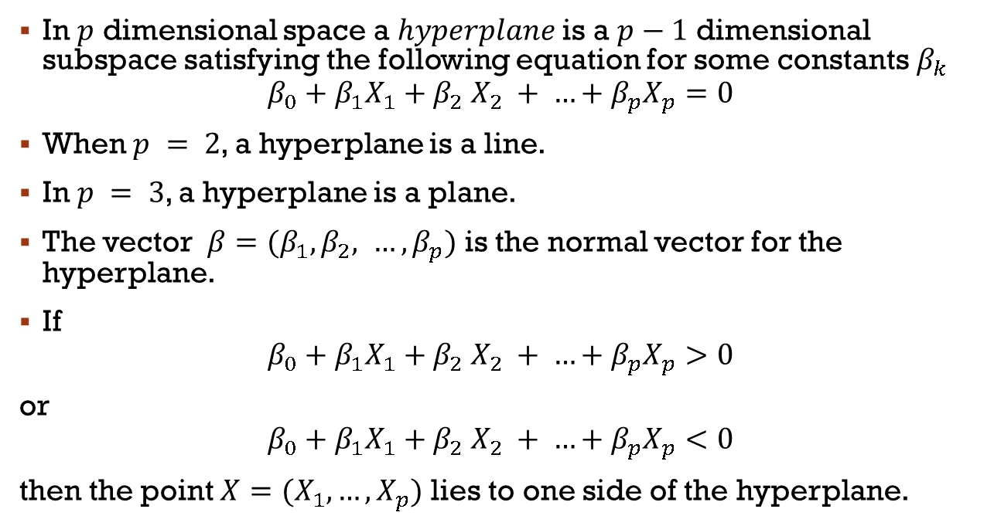
hyperplane
In $p$ dimensional space a $hyperplane$is a $p−1$ dimensional subspace satisfying the following equation for some constants $β_{k}$
$$β_{0}+β_{1}X_{1}+β_{2} X_{2} + …+β_{p}X_{p}=0$$
When $p = 2$, a hyperplane is a line.
In $p = 3$, a hyperplane is a plane.
The vector $β=(β_{1}, β_{2}, …,β_{p})$ is the normal vector for the hyperplane.
If
$$β_{0}+β_{1}X_{1}+β_{2} X_{2} + …+β_{p}X_{p}>0$$
or
$$β_{0}+β_{1}X_{1}+β_{2} X_{2} + …+β_{p}X_{p}<0$$
then the point $X=(X_{1},…,X_{p})$ lies to one side of the hyperplane.

Slide 3
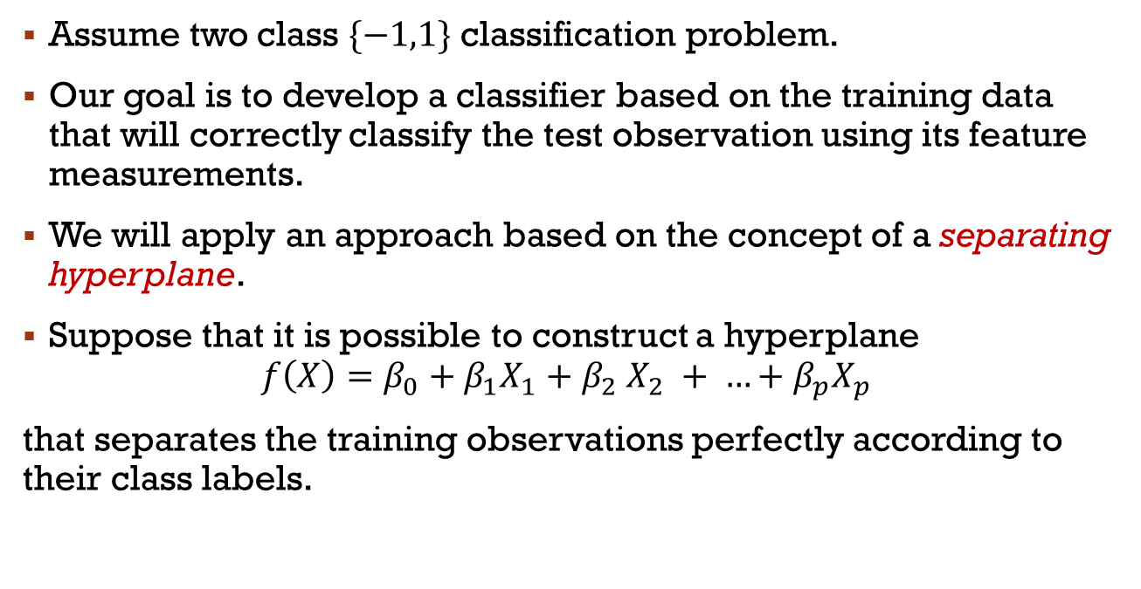
Classification by a hyperplane
Assume two class $\{−1,1\}$ classification problem.
Our goal is to develop a classifier based on the training data that will correctly classify the test observation using its feature measurements.
We will apply an approach based on the concept of a separating hyperplane.
Suppose that it is possible to construct a hyperplane
$$f\left(X\right)=β_{0}+β_{1}X_{1}+β_{2} X_{2} + …+β_{p}X_{p}$$
that separates the training observations perfectly according to their class labels.

Slide 4
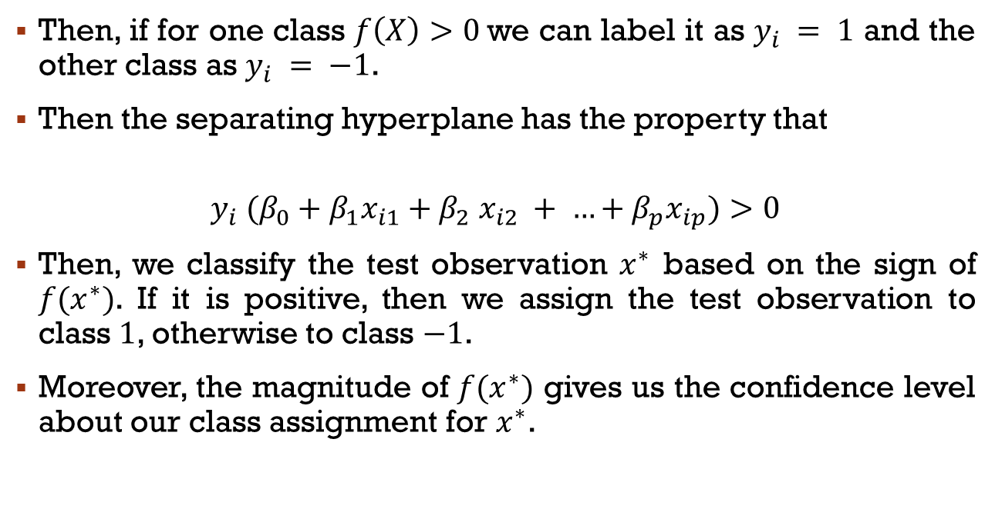
Classification by a hyperplane
Then, if for one class $f\left(X\right)>0$we can label it as $y_{i} = 1$ and the other class as $y_{i} = −1$.
Then the separating hyperplane has the property that
$$y_{i} (β_{0}+β_{1}x_{i1}+β_{2} x_{i2} + …+β_{p}x_{ip})>0$$
Then, we classify the test observation $x^{∗}$ based on the sign of $f(x^{∗})$. If it is positive, then we assign the test observation to class $1$, otherwise to class $−1$.
Moreover, the magnitude of $f(x^{∗})$ gives us the confidence level about our class assignment for $x^{∗}$.

Slide 5
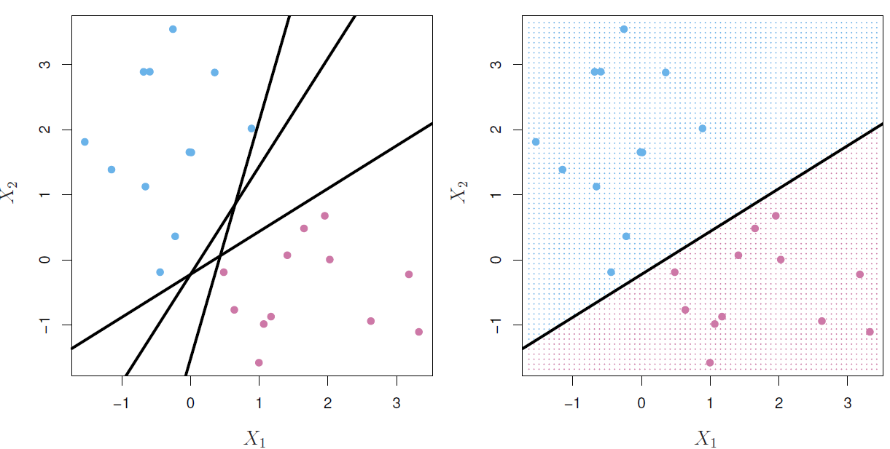
illustration

Slide 6
Maximal margin Classifier

Slide 7
Optimal separating hyperplane
Imagine a situation where you have a two class classification problem.
Suppose that the two classes are “linearly separable” i.e. one can draw a hyperplane and all points on one side belong to the first class and points on the other side to the second class.
Then a natural approach is to find a hyperplane (optimal separating hyperplane) that gives the biggest separation (highest confidence) between the classes i.e. the points are as far from the hyperplane as possible.
This is the basic idea of a maximal margin classifier.
Minimal distance from the observations to the hyperplane is known as the margin.

Slide 8
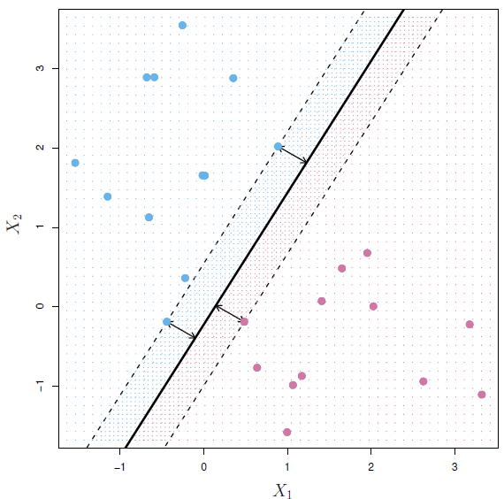
illustration
Three training observations are equidistant from the maximal margin hyperplane.
These three observations are known as support vectors and they support the maximal margin hyperplane in the sense that if these points were moved slightly then the hyperplane would move as well.

Slide 9

construction
$$\max_{β_{0},β_{1},…,β_{p}}{M}$$
$$subject to{\sum_{j=1}^{p}{β_{j}^{2}}=1}$$
$$y_{i} \left(β_{0}+β_{1}x_{i1}+β_{2} x_{i2} + …+β_{p}x_{ip}\right)≥M, i=1,…,n$$

Slide 10
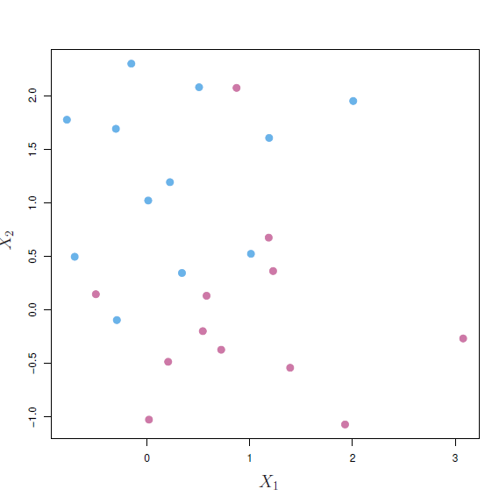
Non-separable data
The two classes are not separable by a hyperplane, and so the maximal margin classifier cannot be used.

Slide 11
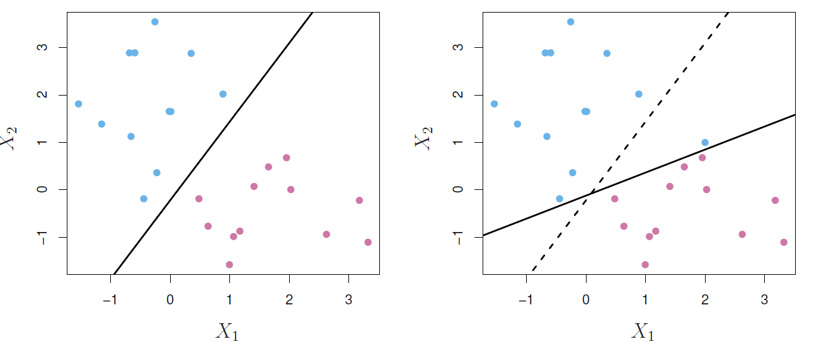
Sensitivity of the classifier
The addition of a single observation leads to a dramatic change in the maximal margin hyperplane.
The resulting maximal margin hyperplane is not satisfactory - for one thing, it has only a tiny margin.

Slide 12
Support vector classifier

Slide 13
New approach
We need:
Greater robustness to individual observations, and
Better classification of most of the training observations
That is, it could be worthwhile to misclassify a few training observations in order to do a better job in classifying the remaining observations.
The support vector classifier, sometimes called a soft margin classifier, does exactly this.
We allow some observations to be on the incorrect side of the margin, or even the incorrect side of the hyperplane.

Slide 14
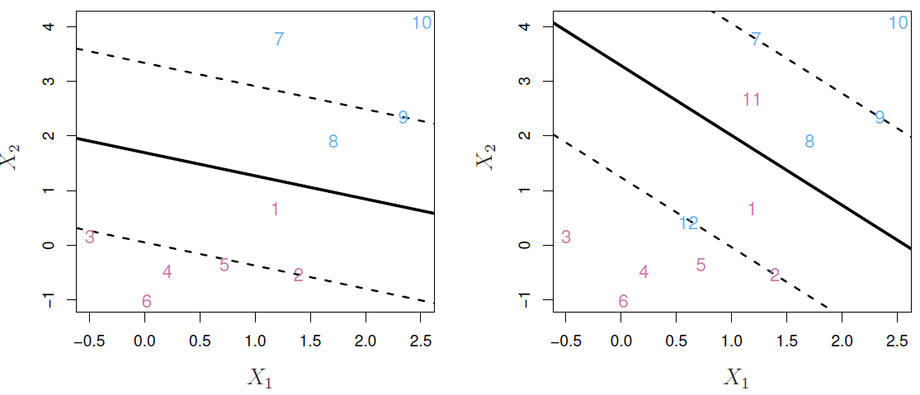
Soft margins
Left: Observations 3, 4, 5, and 6 are on the correct side of the margin, observation 2 is on the margin, and observation 1 is on the wrong side of the margin. Observations 7 and 10 are on the correct side of the margin, observation 9 is on the margin, and observation 8 is on the wrong side of the margin. No observations are on the wrong side of the hyperplane.
Right: Same as left panel with two additional points, 11 and 12 on the wrong side of the hyperplane and the wrong side of the margin.

Slide 15

construction
$$\max_{β_{0},β_{1},…,β_{p},e_{1},…,e_{n}}{M}$$
$$subject to{\sum_{j=1}^{p}{β_{j}^{2}}=1}$$
$$y_{i} \left(β_{0}+β_{1}x_{i1}+β_{2} x_{i2} + …+β_{p}x_{ip}\right)≥M\left(1−e_{i}\right), i=1,…,n$$
$$e_{i}≥0, \sum_{i=1}^{n}{e_{i}}≤C$$

Slide 16
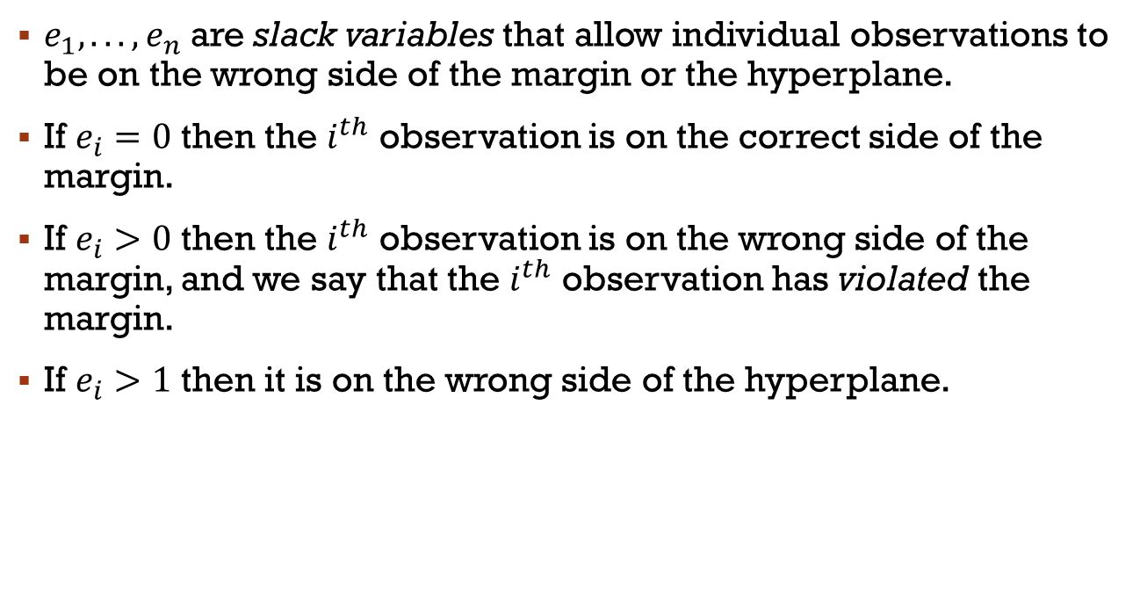
parameters
$e_{1}, . . . , e_{n}$ are slack variables that allow individual observations to be on the wrong side of the margin or the hyperplane.
If $e_{i}=0$ then the $i^{th}$ observation is on the correct side of the margin.
If $e_{i}>0$ then the $i^{th}$ observation is on the wrong side of the margin, and we say that the $i^{th}$ observation has violated the margin.
If $e_{i}>1$ then it is on the wrong side of the hyperplane.

Slide 17
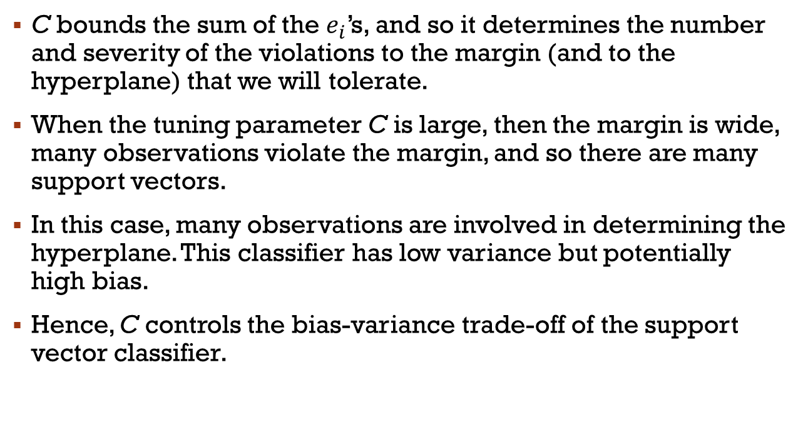
parameters
C bounds the sum of the $e_{i}$’s, and so it determines the number and severity of the violations to the margin (and to the hyperplane) that we will tolerate.
When the tuning parameter C is large, then the margin is wide, many observations violate the margin, and so there are many support vectors.
In this case, many observations are involved in determining the hyperplane. This classifier has low variance but potentially high bias.
Hence, C controls the bias-variance trade-off of the support vector classifier.

Slide 18
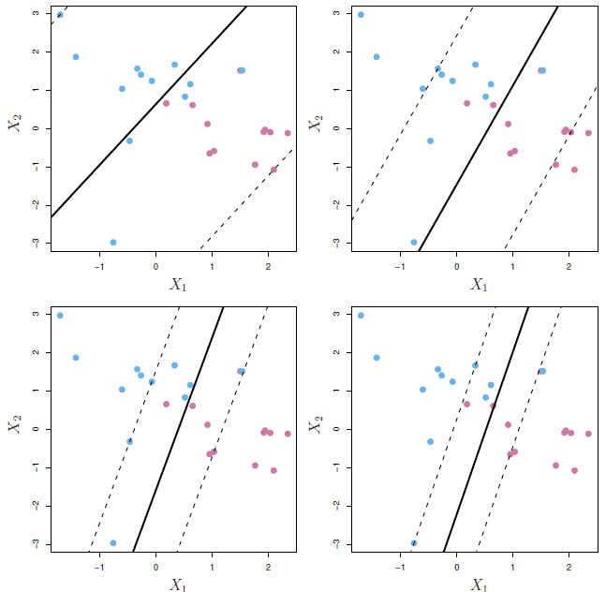
c is a regularization parameter
A support vector classifier was fit using four different values of the tuning parameter C.
The largest value of C was used in the top left panel, and the smallest in the bottom right panels.
When C is large, then there is a high tolerance for observations being on the wrong side of the margin, and so the margin will be large.

Slide 19
properties
It turns out that only observations that either lie on the margin or that violate the margin will affect the hyperplane.
An observation that lies strictly on the correct side of the margin does not affect the support vector classifier!
Changing the position of that observation would not change the classifier at all, provided that its position remains on the correct side of the margin.
Observations that lie directly on the margin, or on the wrong side of the margin for their class, are known as support vectors. These observations affect the support vector classifier.

Slide 20
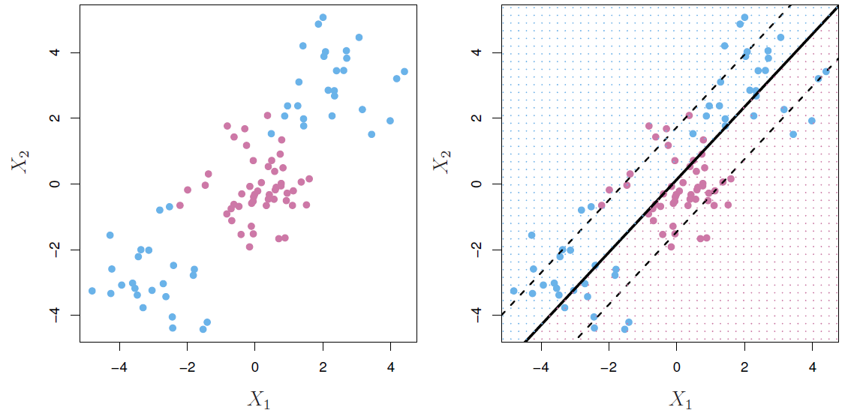
Non-linear boundaries
In practice we are sometimes faced with non-linear class boundaries.
It is clear that a support vector classifier or any linear classifier will perform poorly
Indeed, the support vector classifier shown in the right-hand panel is useless.

Slide 21
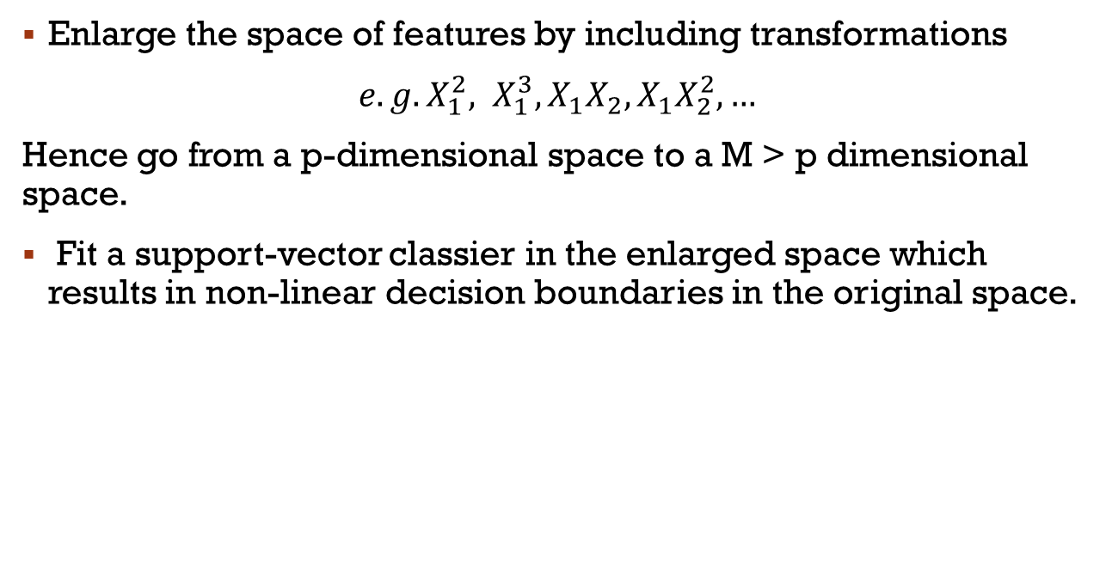
Non-linear decision boundaries
Enlarge the space of features by including transformations
$e.g. X_{1}^{2}, X_{1}^{3}, X_{1}X_{2}, X_{1}X_{2}^{2},…$
Hence go from a p-dimensional space to a M > p dimensional space.
Fit a support-vector classier in the enlarged space which results in non-linear decision boundaries in the original space.

Slide 22
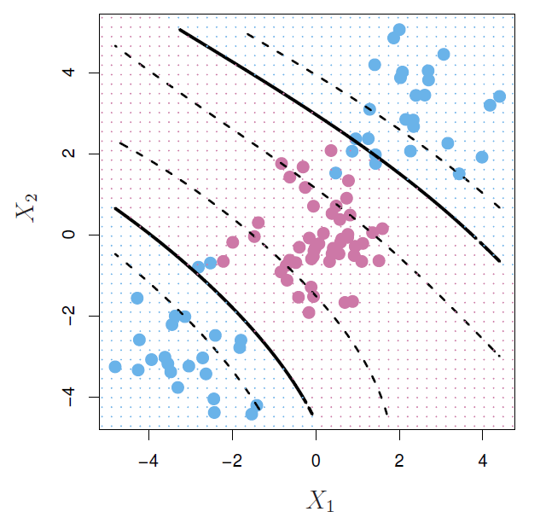
Example: Cubic polynomials
$$β_{0}+β_{1}X_{1}+β_{2}X_{2}+β_{3}X_{1}^{2}+β_{4}X_{2}^{2}+β_{5}X_{1}X_{2}+β_{6}X_{1}^{3}+β_{7}X_{2}^{3}+β_{8}X_{1}X_{2}^{2}+β_{9}X_{1}^{2}X_{2}=0$$

Slide 23
problems
There are many possible ways to enlarge the feature space and we could end up with a huge number of features.
Then computations would become unmanageable.
The support vector machine, which we present next, allows us to enlarge the feature space used by the support vector classifier in a way that leads to efficient computations.

Slide 24
Support vector machines

Slide 25
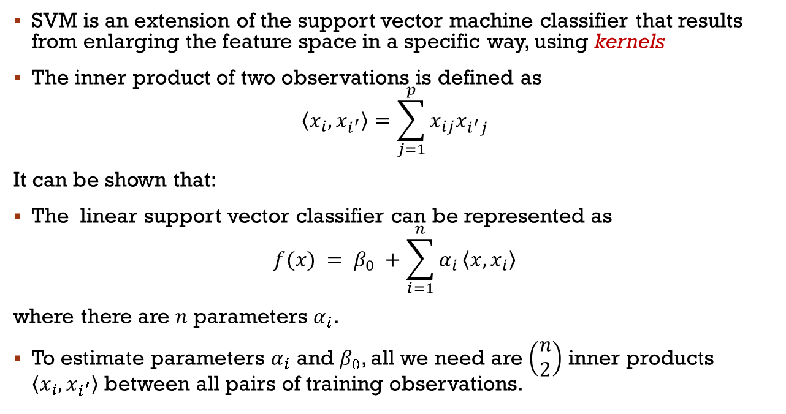
Understanding the SVC
SVM is an extension of the support vector machine classifier that results from enlarging the feature space in a specific way, using kernels
The inner product of two observations is defined as
$$\left\langle x_{i},x_{i^{′}}\right\rangle =\sum_{j=1}^{p}{x_{ij}x_{i^{′}j}}$$
It can be shown that:
The linear support vector classifier can be represented as
$$f(x) = β_{0} +\sum_{i=1}^{n}{α_{i}}\left\langle x,x_{i}\right\rangle$$
where there are $n$ parameters $α_{i}$.
To estimate parameters $α_{i}$ and $β_{0}$, all we need are $\left(\begin{matrix}n \\ 2\end{matrix}\right)$ inner products $\left\langle x_{i},x_{i^{′}}\right\rangle$ between all pairs of training observations.

Slide 26
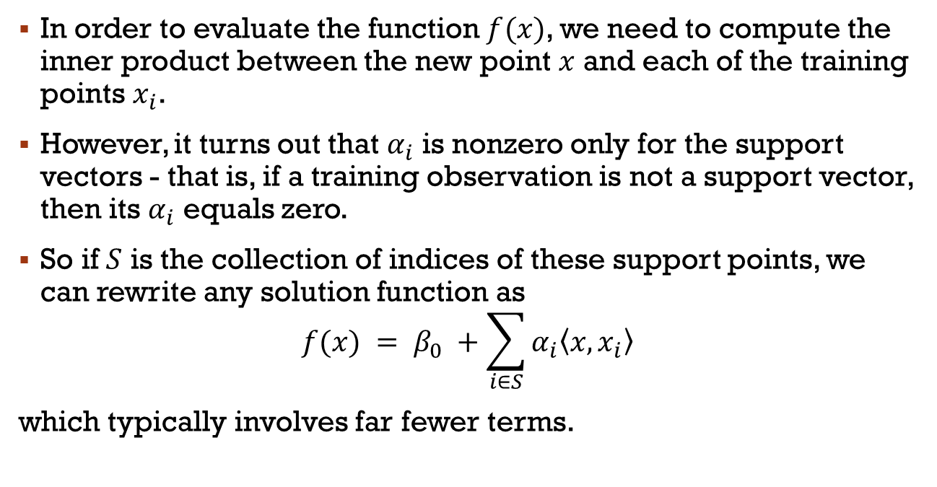
Understanding the SVC
In order to evaluate the function $f(x)$, we need to compute the inner product between the new point $x$ and each of the training points $x_{i}$.
However, it turns out that $α_{i}$ is nonzero only for the support vectors - that is, if a training observation is not a support vector, then its $α_{i}$ equals zero.
So if $S$ is the collection of indices of these support points, we can rewrite any solution function as
$$f(x) = β_{0} +\sum_{i∈S}{α_{i}\left\langle x,x_{i}\right\rangle }$$
which typically involves far fewer terms.

Slide 27
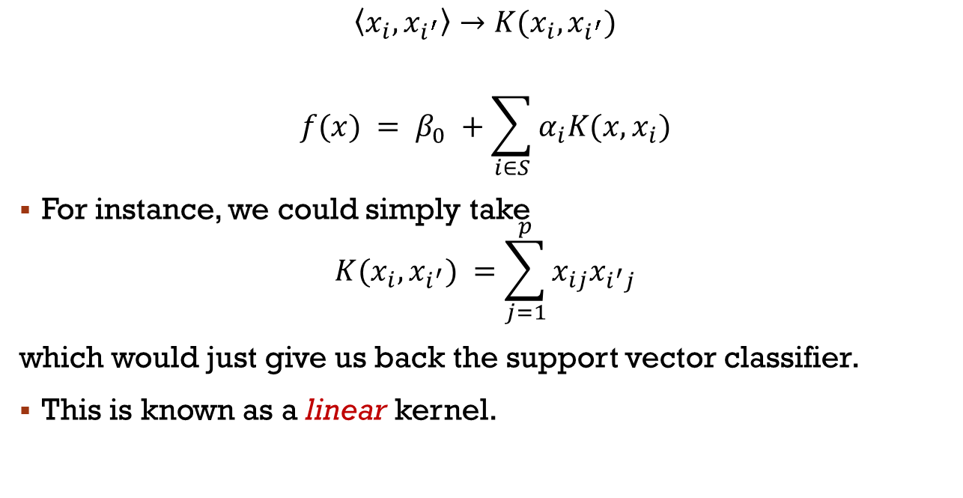
svm
$$\left\langle x_{i},x_{i^{′}}\right\rangle →K(x_{i},x_{i^{′}})$$
$$f(x) = β_{0} +\sum_{i∈S}{α_{i}K(x,x_{i})}$$
For instance, we could simply take
$$K(x_{i}, x_{i^{′}}) =\sum_{j=1}^{p}{x_{ij}x_{i^{′}j}}$$
which would just give us back the support vector classifier.
This is known as a linear kernel.

Slide 28
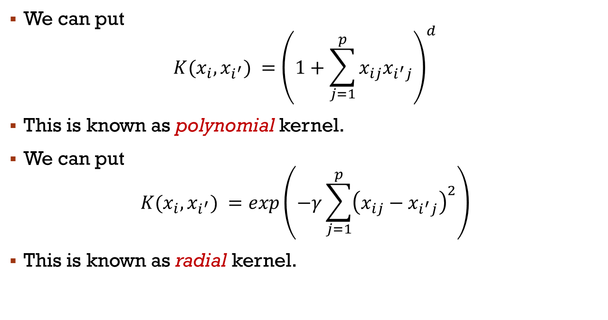
Non-linear kernels
We can put
$$K(x_{i}, x_{i^{′}}) ={\left(1+\sum_{j=1}^{p}{x_{ij}x_{i^{′}j}}\right)}^{d}$$
This is known as polynomial kernel.
We can put
$$K(x_{i}, x_{i^{′}}) =exp\left(−γ\sum_{j=1}^{p}{{\left(x_{ij}−x_{i^{′}j}\right)}^{2}}\right)$$
This is known as radial kernel.

Slide 29
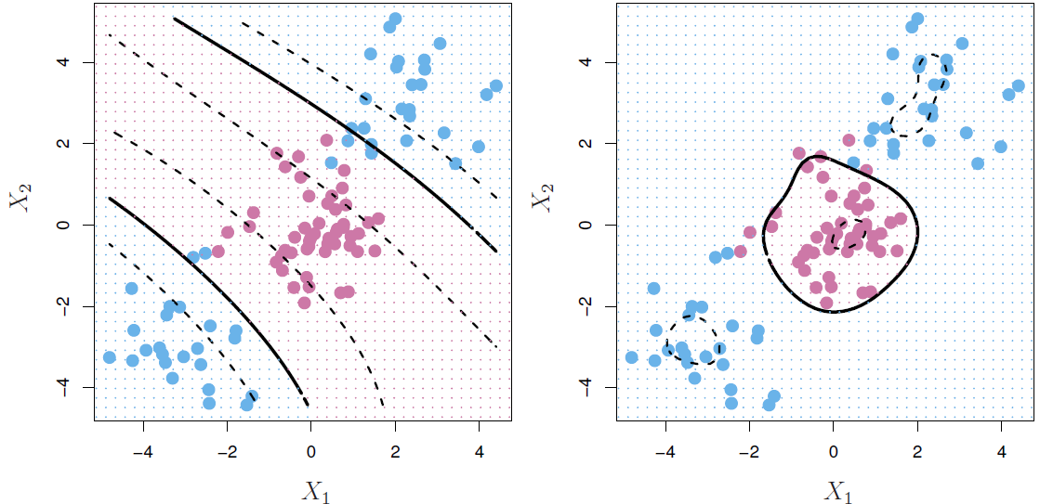
Radial kernel
Left: An SVM with a polynomial kernel of degree 3 is applied to the non-linear data, resulting in a far more appropriate decision rule.
Right: An SVM with a radial kernel is applied. In this example, either kernel is capable of capturing the decision boundary.

Slide 30
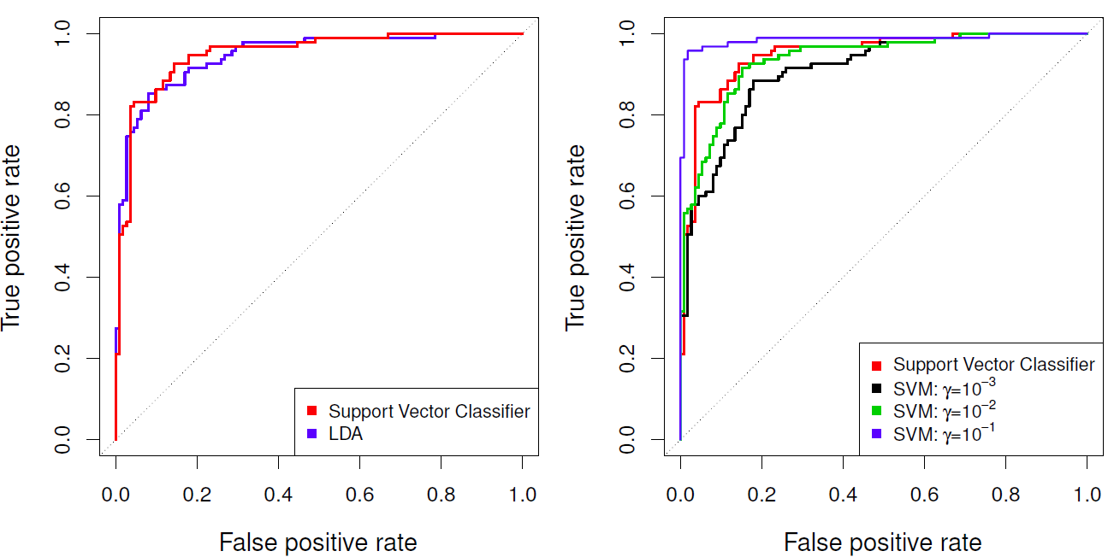
Heart data: ROC curves - training data
Predicting heart disease

Slide 31
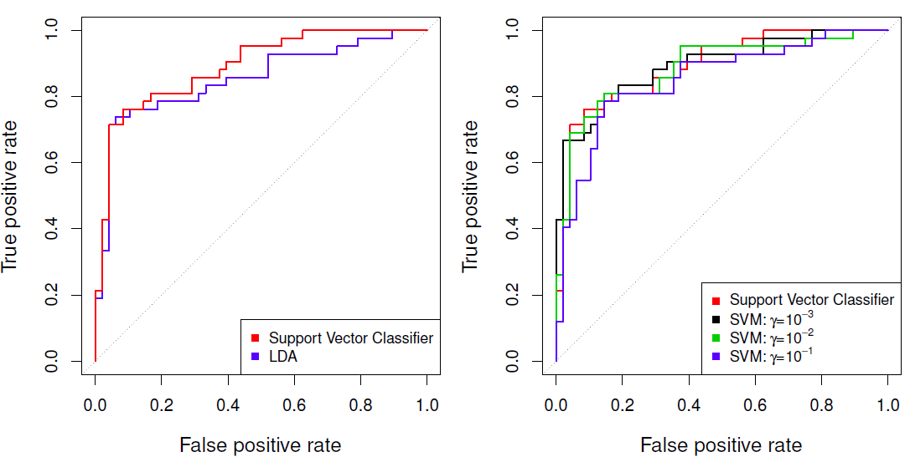
Heart data: ROC curves - test data
Predicting heart disease

Slide 32
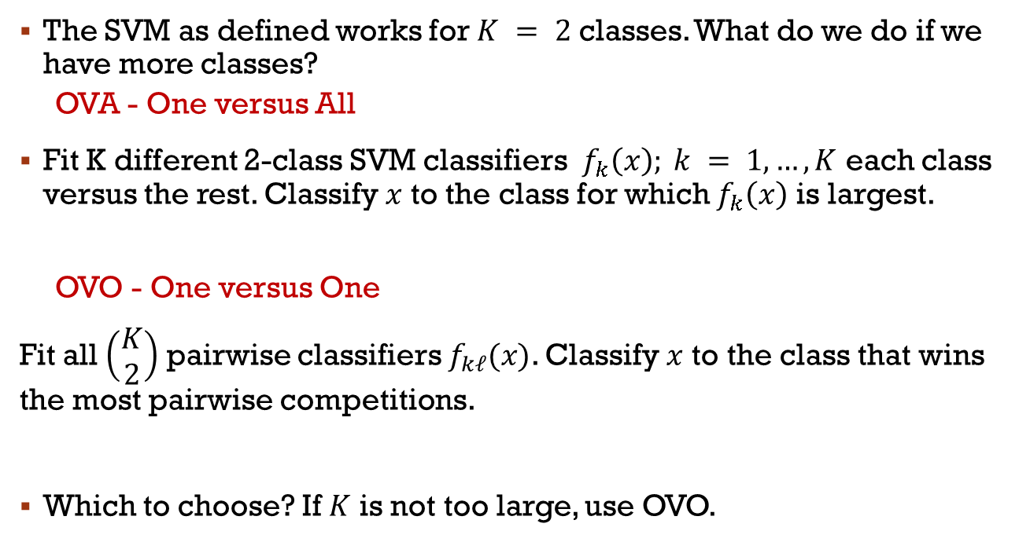
More than two classes
The SVM as defined works for $K = 2$ classes. What do we do if we have more classes?
OVA - One versus All
Fit K different 2-class SVM classifiers $f_{k}\left(x\right); k = 1,…,K$ each class versus the rest. Classify $x$ to the class for which $f_{k}\left(x\right)$ is largest.
OVO - One versus One
Fit all $\left(\begin{matrix}K \\ 2\end{matrix}\right)$ pairwise classifiers $f_{kℓ}(x)$. Classify $x$ to the class that wins the most pairwise competitions.
Which to choose? If $K$ is not too large, use OVO.

